Slide 1
Project Amazon Pricing by Kiyoshi Iwaki
< Target> is to find out
1. How does ranking affect an item's price?
2. How does vendor affect price?
<Data>
How We Analyzed Amazon’s Shopping Algorithm
(article of Propublica)

Slide 2
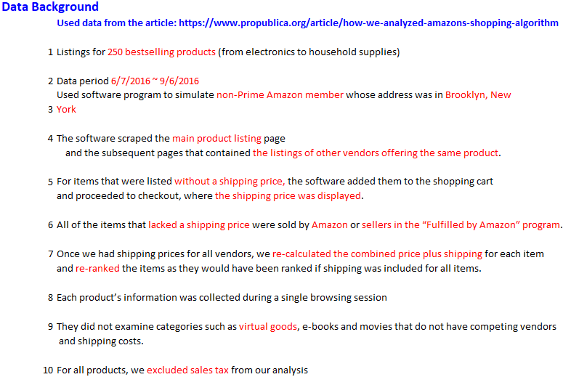

Slide 3
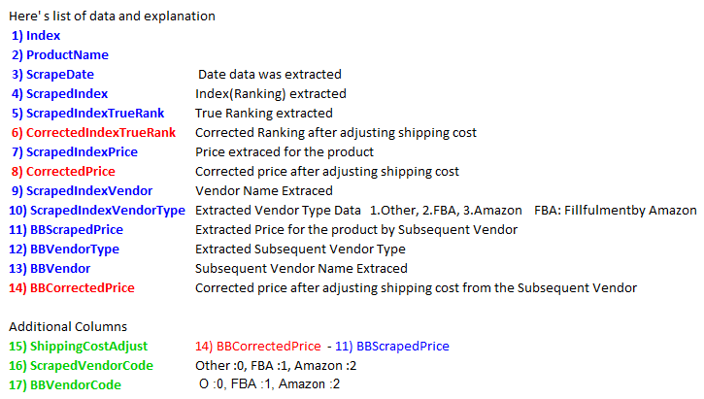

Slide 4
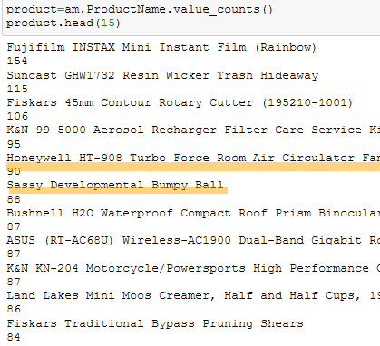
Top List of Product Appearance Frequency

Slide 5
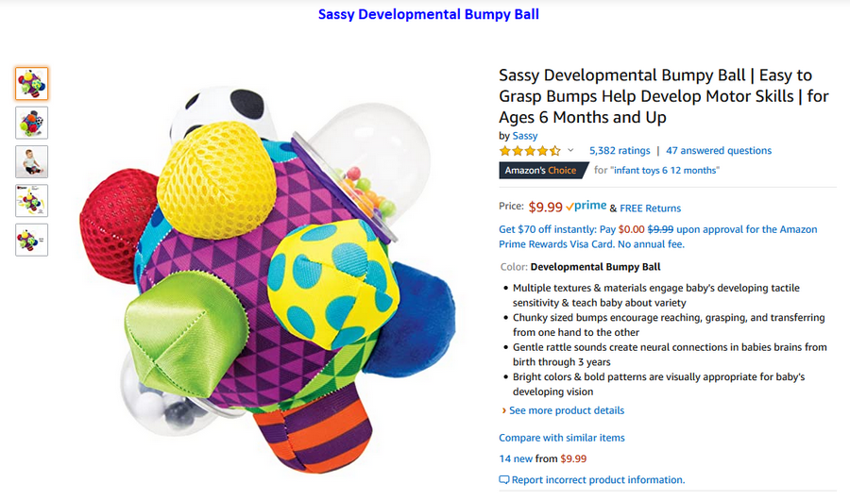
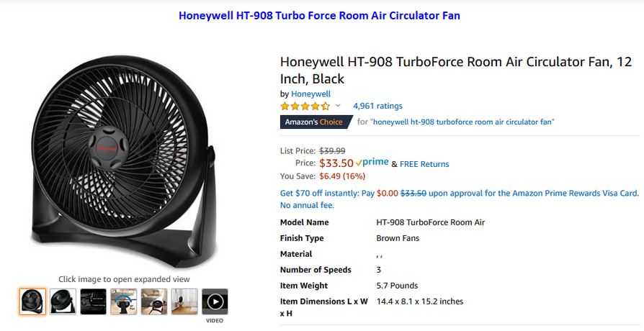
Select 2 Products 1) Honeywell HT-908 Turbo Force Room Air Circulator Fan 2) Sassy Developmental Bumpy Ball

Slide 6


Product Data Sample

Slide 7


Other vendors listed price w/o shipping

Slide 8

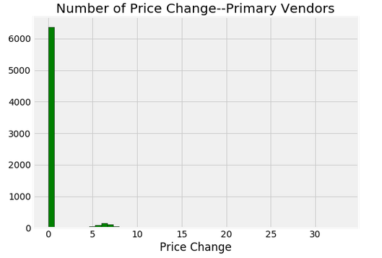
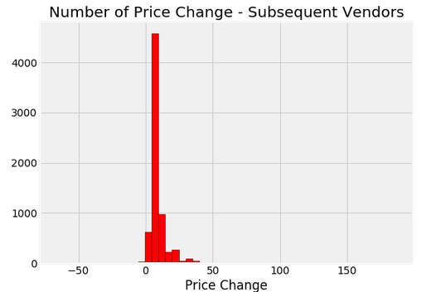
Price Change by Primary and Subsequent Vendors

Slide 9
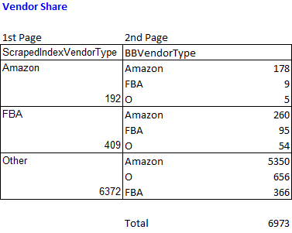


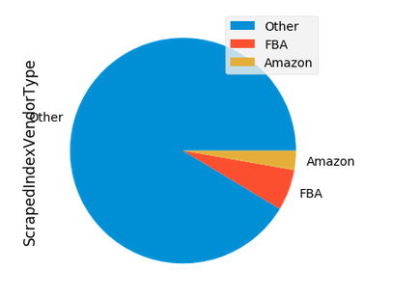
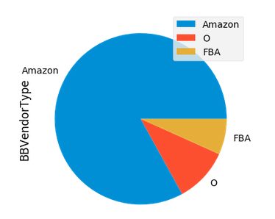
Another Observation

Slide 10

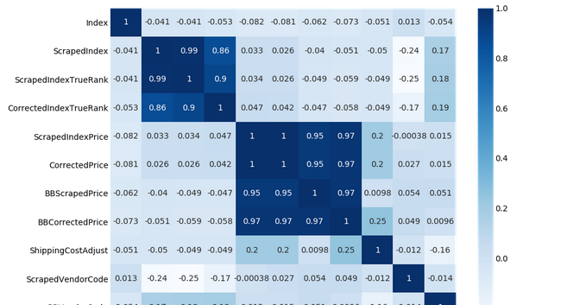

Slide 11
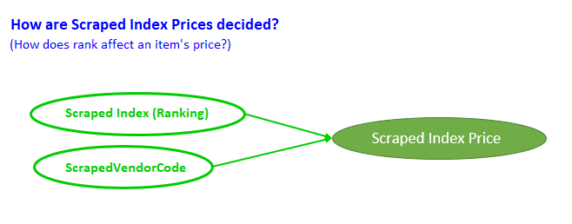



Slide 12
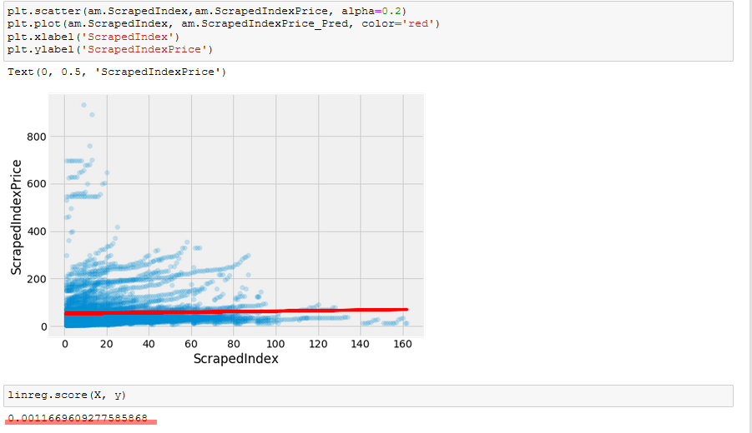
→R-Squared is low

Slide 13

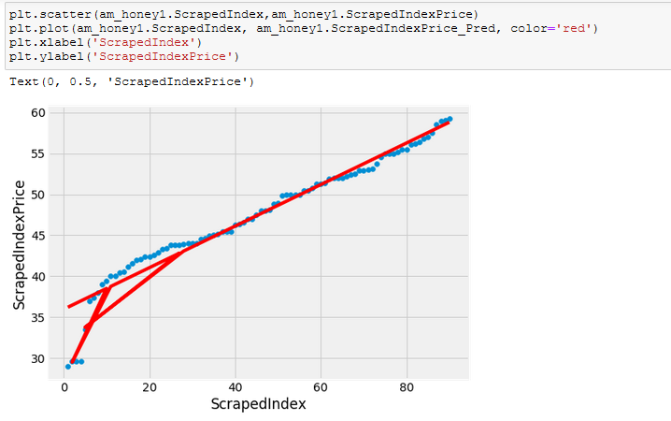
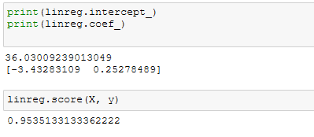

Slide 14

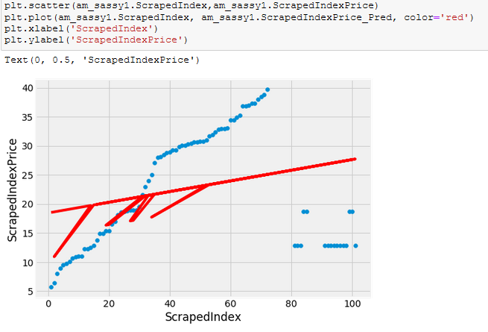
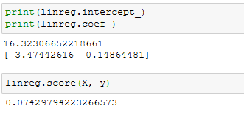

Slide 15



Slide 16
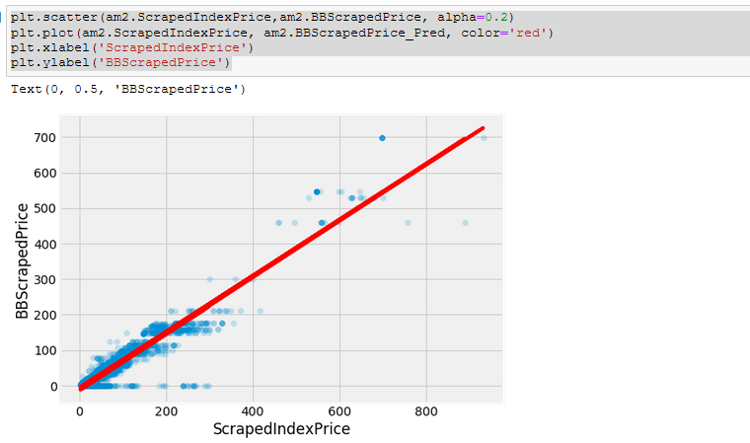


Slide 17
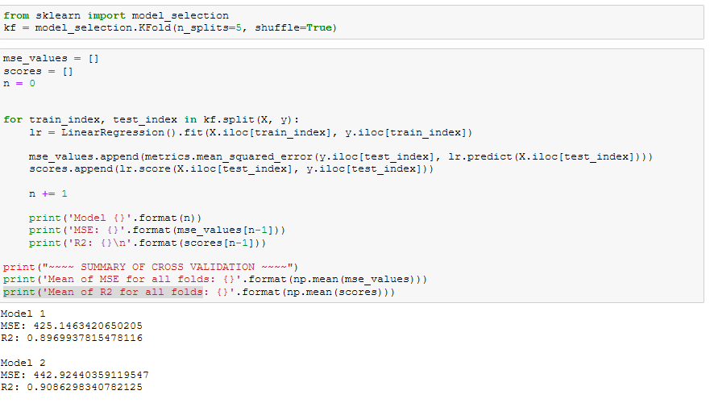
5-Fold Cross Validation conducted

Slide 18
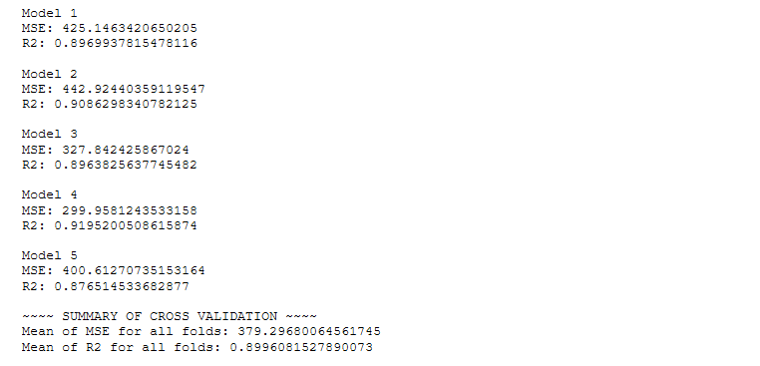
5-Fold Cross Validation conducted (2)

Slide 19
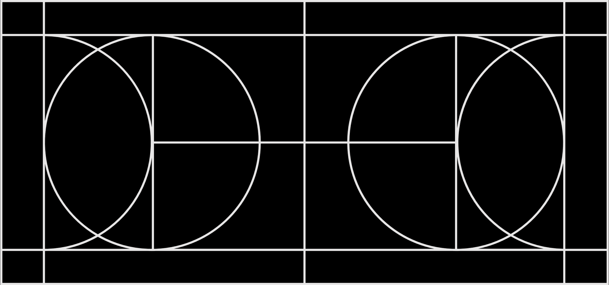

Next Projects

